Slide 1
Urban Poling An Introduction to the Sport and its Benefits for Mental Health

Slide 2
What is Urban Poling ?
Urban Poling, also known as Nordic walking, is a growing fitness and wellness physical activity trend targeting aerobic + strength training by combining specialized poles with walking.
urban poling =
cross-country skiing + walking

Slide 3
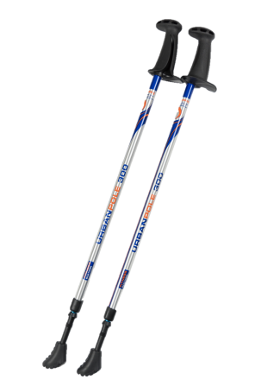
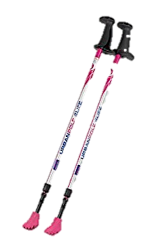
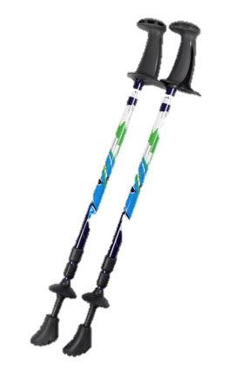
Poles for any AGE AND STAGE
Nordic Walking is for anyone and everyone – one size fits all! The poles are height adjustable but also collapsible.
Fitness Poles
Aimed to propel the user forward
ACTIVATOR™ Poles
Ideal for anyone requiring more stability and balance

Slide 4
URBAN POLING IN ACTION: DAILY DOSE OF VITAMIN N…..NATURE

Slide 5
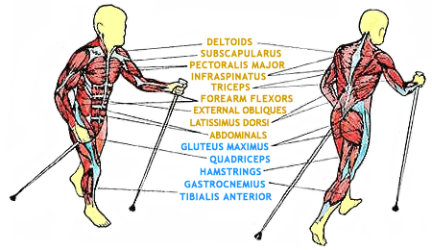
What is Urban Poling aka Nordic Walking?
The Urban Poling technique is designed specifically to:
Engage most muscles – nearly 90%
Increase caloric expenditure by 20-46%
Target major core muscles
Promote good posture, balance & stability
Reduce impact on knee & hip joints
Provide a safe and ergonomic handle
(maintaining hand/wrist in neutral & wide grip position)
1 Km (proper technique)= 1000 abdominal contractions

Slide 6
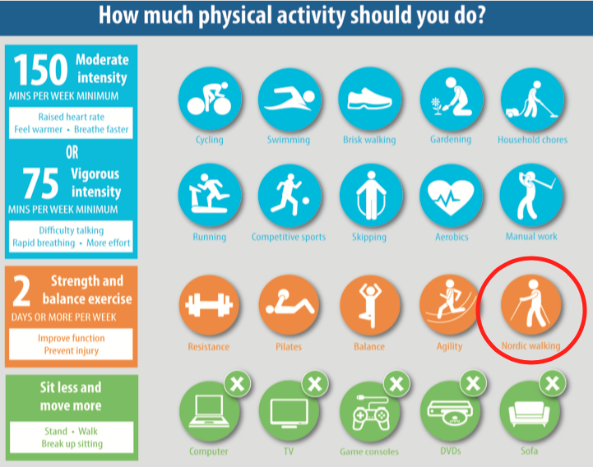
World Confederation for Physical Therapy

Slide 7
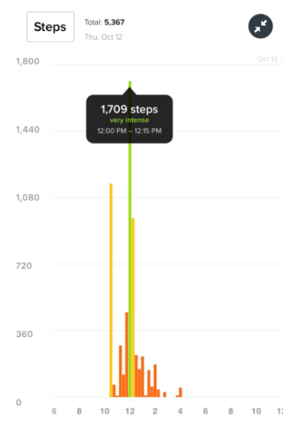
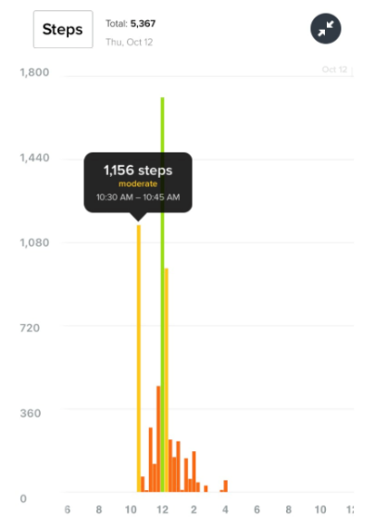
Why Be Moderate – When you can be intense?
15 Minute regular Walk
15 Minute Nordic Walk

Slide 8
Benefits of NW FOR EVERYONE
Nordic Walking is a combination of Aerobic Exercise and Resistance Exercise
200+ Studies on the Benefits of Nordic Walking for an array of conditions including:
Arthritis/Pre-Post Hip & Knee
Diabetes
Parkinson's / Stroke/ ABI
Spinal
8 studies (published/ongoing) on the ACTIVATOR™ Poles specifically across Canada, United Kingdom and Australia
Cardiac Health/Rehab
Breast Cancer Rehab
Weight Management
Notes:
https://www.ncbi.nlm.nih.gov/pubmed/19528847

Slide 11
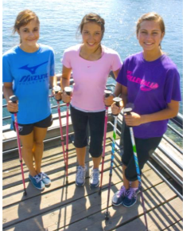
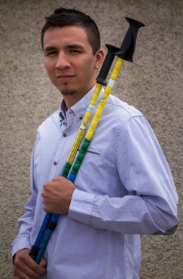
Prevalence of Mental Health in Adolescence and Young Adulthood – Why look to exercise
Mental Health
70% of Mental Health Problems have their onset during childhood or adolescence¹¹
Individuals aged 15-24 are more likely to experience mental illness and or substances use disorders than any other age group¹¹
Struggle with Self Confidence and Body Image^{12,13}
50-88% of adolescent girls feel negatively about their body shape or size.
Females are much more likely than males to think their current size is too large (66% vs. 21%).
Over one-third of males think their current size is too small.
Need for Independence: Participating in an active lifestyle can assist with establishing good habits and behaviours for later in life !
Notes:
1. http://www.camh.ca/en/hospital/about_camh/newsroom/for_reporters/Pages/addictionmentalhealthstatistics.aspx
2. Body Image : http://www.epi.umn.edu/let/pubs/img/adol_ch13.pdf
EPM Communications. Youth Markets Alert 2000;12:8. , Field AE, Cheung L, Wolf AM, Herzog DB, Gortmaker SL, Colditz GA. Exposure to the mass media and weight concerns among girls. Pediatrics 1999;103(3):E36
B,c. Rand CS, Resnick JL, Seldman RS. Assessment of socially acceptable body sizes by university students. Obes Res 1997;5(5):425-429.
3.
http://journal.lspa.lv/files/2014/Review_LASE_Journal_2014_5.pdf
Piotrowska (2011) obtained interesting results while studying the assessment of physical capacity and body composition of boys leading a sedentary lifestyle. The author researched two groups of 17-18 years old boys. The first group of 46 boys regularly took part in physical education classes, while the second group (29 boys) avoided them. Boys from the second group were encouraged to engage in Nordic waking classes 3 times a week throughout the school year. The average differences observed in the Nordic walking group in comparison with the first group indicate a considerable advancement in their results. A significant improvement was observed in body weight, composition of the adipose tissue, 50m running ability, arm bending for pull-ups, crouching from a recumbent position and shuttle running 4x10m. No negative changes of somatic or functional parameters where observed.

Slide 12
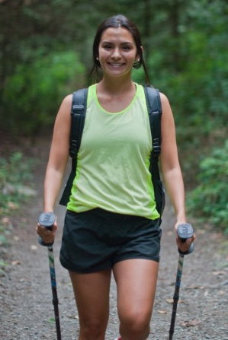
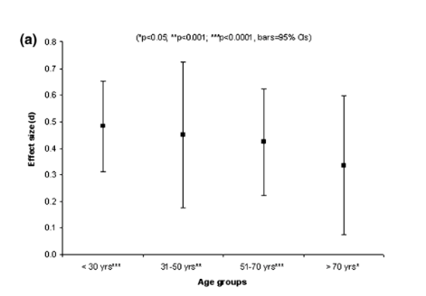
Exercise & Mental Health
Research shows a correlation between exercise and reduced levels of anxiety and depression ¹⁴
2010 Meta Analysis in Journal of Environmental Science and Technology highlights that “Green Exercise” (Exercise in presence of nature) is beneficial at improving both self esteem and mood (Markers of Mental Health)¹⁵
Self Esteem statistically improved the most in the youngest age group exercising in Green Space
GREEN SPACE ON SELF-ESTEEM ON AGE
Notes:
We Like to say that going for a nordic walk is a great way to get your daily dose of Vitamin N…. Nature !
1. http://www.camh.ca/en/hospital/about_camh/newsroom/for_reporters/Pages/addictionmentalhealthstatistics.aspx
2. http://pubs.acs.org.subzero.lib.uoguelph.ca/doi/ipdf/10.1021/es903183r
3) https://www.ncbi.nlm.nih.gov/pubmed/?term=What+is+the+Best+Dose+of+Nature+and+Green+Exercise+for+Improving+Mental+Health%3F+A+Multi-Study+Analysis

Slide 13
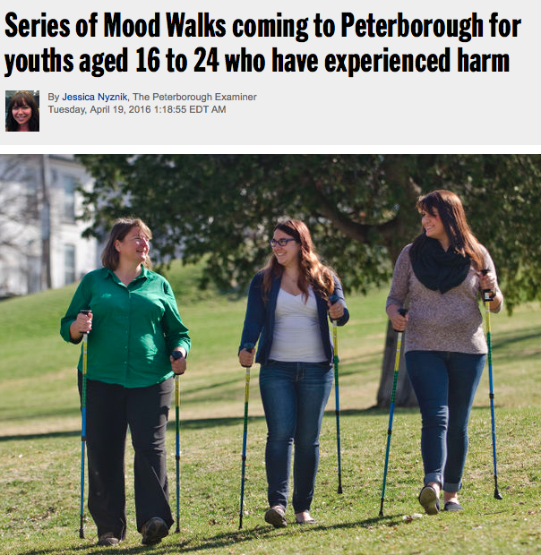
Mood walks program: Kawartha Sexual Assault Centre Peterborough, ON
MOOD Walks¹⁷
Led by Canadian Mental Health Association-Ontario
10 Week program geared toward youth ages 16-24 90-120 min walks through city & park trails
During the walks, participants can use walking poles to maximize the exercise element of the walk… Research shows that the poles help with more oxygen intake which helps release more endorphins aiding in stress release and mood.
“With all the transitions young people experience, they're an at-risk group for mental health issues… & they often experience long wait times for mental health services in ON. We just wanted to provide an alternative route to help” -Shaya Macdonald, SW Student @ CMHA
Notes:
Mood walks program for youth ontario www.moodwalks.ca Cite article – Mood walks peterborough – See diana’s email
Research Article:
https://www.ncbi.nlm.nih.gov/pubmed/19065108

Slide 14
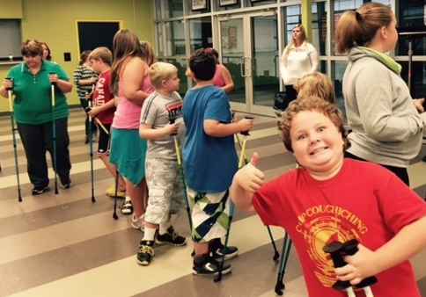
CHAT CLINIC
The Orillia Solders Memorial Hospital launched a CHAT Clinic (Choosing Healthy Actions Together) aimed towards helping families combat the rise in childhood obesity.
The CHAT Clinic included Urban Poling sessions and highlighted that “Adults and children alike loved walking with the poles. It seemed to add another dimension to walking which made our typical walk, atypical!”

Slide 15
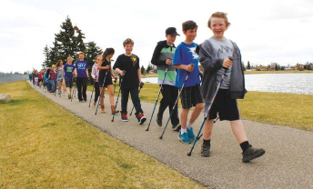
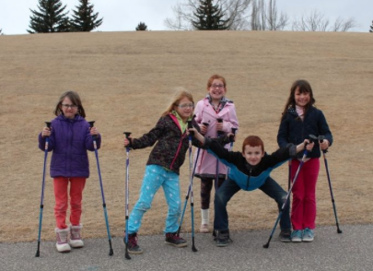
High River, Alberta-École Joe Clark School
“The program provides student with a unique sporting experience that they can easily get excited about… A lot of sports done in gym class are team/opponent sports where as Urban Poling is more individual… It is very personal so they can set targets for themselves and really learn how to work their own bodies”
“The students’ response is that it [Urban Poling] is “just fun” and they feel no pressure to perform. The teachers appreciate that it allows the children to get a total body workout, while experiencing the outdoors”.
Source: High River Times
Notes:
Spring 2016 Urban Poling Introduced to Students of High River Alberta
http://www.highrivertimes.com/2016/04/14/joe-clark-school-introduces-nordic-walking-program

Slide 16
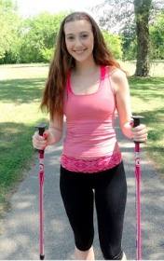
Winnipeg-Lois Riel School District
Lori Hildebrandt a physical education teacher with the Lois Riel School District in Winnipeg found that Urban Poling received two thumbs up from an all-girls high school physical education class: “The girls who tended to be less active and less interested in athletics really enjoyed this activity and its social aspect, while the more athletic class members got a lot out of it as well!”
“Girls who participate in sports are less likely to be depressed, more likely to reach higher academic goals, and more likely to demonstrate improved self-confidence and body image^{13”}
Notes:
1. https://www.ncbi.nlm.nih.gov/pmc/articles/PMC3871410/

Slide 17
Thank you ! If you would like to learn more-visit www.urbanpoling.com Questions? gabriella@urbanpoling.com

